Slide 1



IPL SCORE PRIDICTION
Team Members: Jenil Italiya Guide by: md. Abdul Aziz
Sumit Devani Master Trainer
Sahil Kharose Edunet Foundation
Karan Rathod
Disclaimer: The content is curated for educational purposes only.

Slide 2
OUTLINE
Abstract
Problem Statement
Aims, Objective & Proposed System/Solution
System Design/Architecture
System Development Approach (Technology Used)
Algorithm & Deployment
Conclusion
Future Scope
References
Video of the Project
Notes:
These are the list of chapters that we are going to cover in these foundation codes. Those are chapter one what are AI and ML? chapter 2 applied Python programming in AI, and chapter 3 is exploratory data analysis for ML.

Slide 3
Abstract
The Indian Premier League (IPL) has emerged as one of the most popular and widely followed cricket tournaments globally, attracting millions of viewers and enthusiasts each year. With its dynamic nature and unpredictable outcomes, accurately predicting match scores becomes a challenging yet fascinating task. In this project, we propose a machine learning-based approach to predict IPL match scores.
We leverage historical match data, including team performance metrics, player statistics, venue conditions, and various contextual factors, to train our predictive models. Through comprehensive feature engineering and model selection techniques, we develop robust algorithms capable of forecasting match scores with high accuracy.

Slide 4
Problem Statement
Predict the overall score of an inning in IPL cricket games. The method uses past
match data, squad composition, pitch conditions, and other criteria to accurately
anticipate scores. The user-friendly interface will provide insights and patterns for
cricket teams, broadcasters, and fans to better estimate IPL match results.

Slide 5
Aim and Objective
The Aim of the project are to:
Enhance Fan Engagement: Provide cricket enthusiasts with valuable insights and predictions about upcoming matches, thereby enhancing their engagement and enjoyment of the game.
Inform Decision-Making: Equip team management, analysts, and broadcasters with predictive analytics to make informed decisions regarding team strategies, player selection, and match commentary.
Facilitate Betting and Fantasy Sports: Assist betting enthusiasts and participants in fantasy cricket leagues by offering predictive models to guide their betting and team selection processes.

Slide 6
Proposed Solution
The "IPL Win Predictor" uses logistic regression to offer predictions about a team's chances of winning an IPL match. To provide real-time forecasts, our algorithm examines a variety of match variables, team performance, and player information.

Slide 7
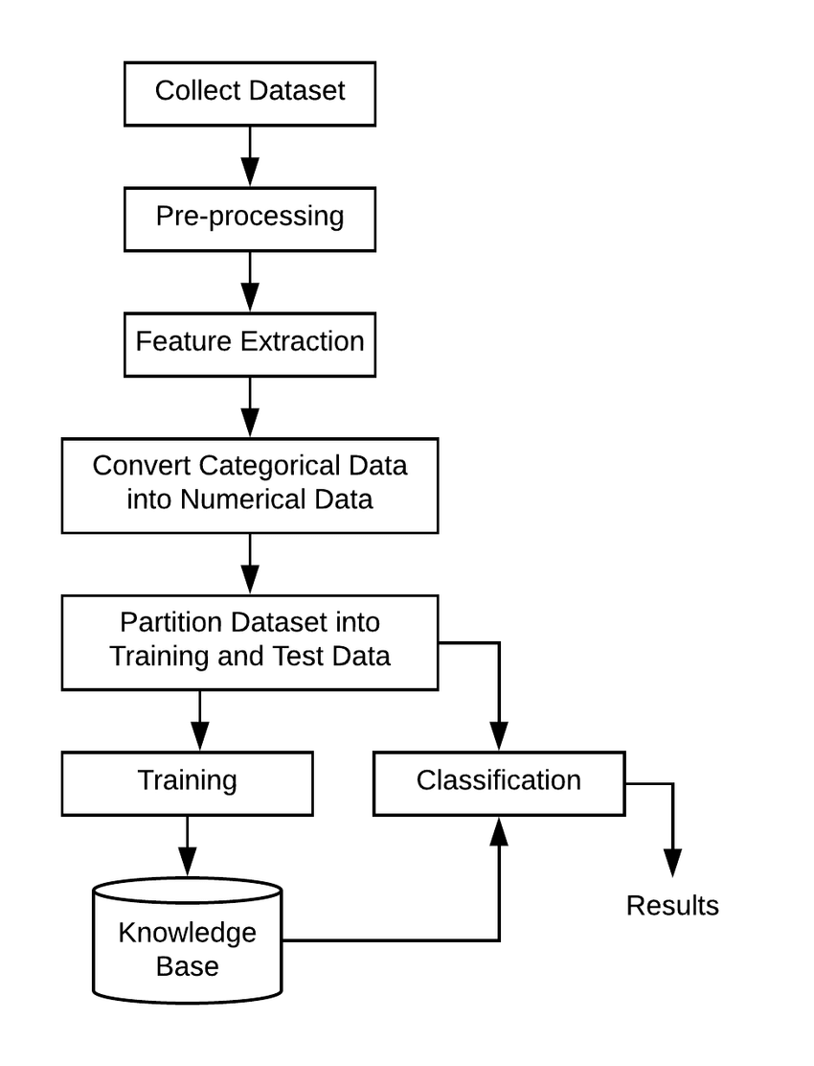
System Architecture

Slide 8
System Deployment Approach
The following technology that are use to develop the system:
Python: python is a programming language that is well-suited for machine learning and data scinence
Decision TreeRegressor(): tries to predict a continuous target variable by cutting the feature variables into small zones, and each zone will have one prediction.
RandomForestRgerressor(): combines multiple decision trees to create a single model.
Matplotlib: is a cross-platform, data visualization and graphical plotting library (histograms, scatter plots, bar charts, etc) for Python and its numerical extension NumPy.

Slide 9
Algorithm & Deployment
The following technology that are use to develop the system:
Linear Regression: Gather historical IPL match data including features such as venue, batting team, bowling team, runs scored in previous overs, wickets fallen, etc.
K-Nearest Neighbor Regressor: nitialize the KNN Regressor with the desired value of K (number of neighbors).Fit the model to the training data, where the features are used to predict the target variable (score).
XGBoost Regressor: Prepare the data in a format suitable for training the XGBoost Regressor. This typically involves encoding categorical variables, handling missing values, and splitting the data into features (X) and target (y)
Random Forest:Initialize a RandomForest Regressor from a machine learning library like scikit-learn in Python. Fit the model to the training data using the fit() method, passing in the features and the target variable.

Slide 10
Conclusion
In conclusion, the IPL score prediction project has demonstrated promising results in leveraging machine learning techniques to forecast cricket match scores. Through rigorous evaluation and testing, the model has showcased its ability to make accurate predictions, contributing to the realm of sports analytics and decision-making.

Slide 11
Future Scope
Enhanced Accuracy
Player Performance Analysis
Audience Engagement
Strategy Optimization
Data Visualization

Slide 12
Reference
https://youtu.be/QVNpTiFsGvw?si=xX66_3e5m9RZoVd2
https://github.com/zep-analytics/IPLScorePredictor
https://streamlit.io/components
Notes:
Reference
These are the references for this session.
12

Slide 13
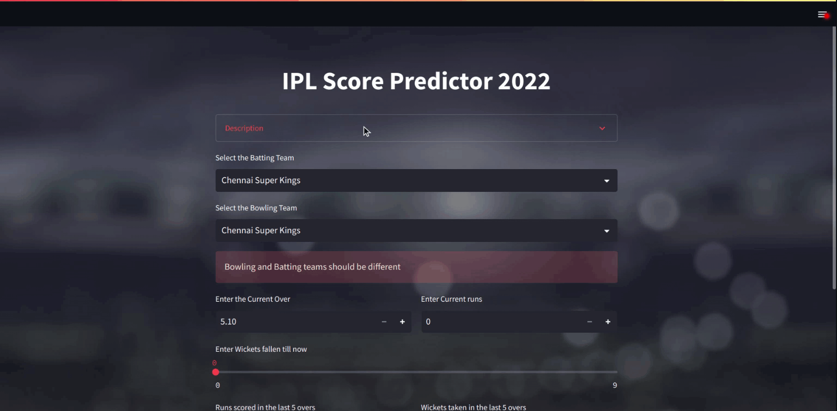

Slide 14
Thank you!
Notes:
thank you very much for joining this PPT, keep learning.
14

